Slide 1
Design and Development of Cyclorotor for Parametric Study of Thrust Vectoring
Abhishek Kandel, Milan Dhami, Ringjing Tamang, Rohit Pati
Supervisor Er. Biman Rimal

Slide 2
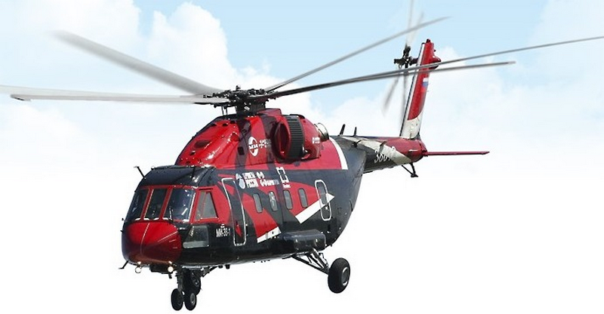
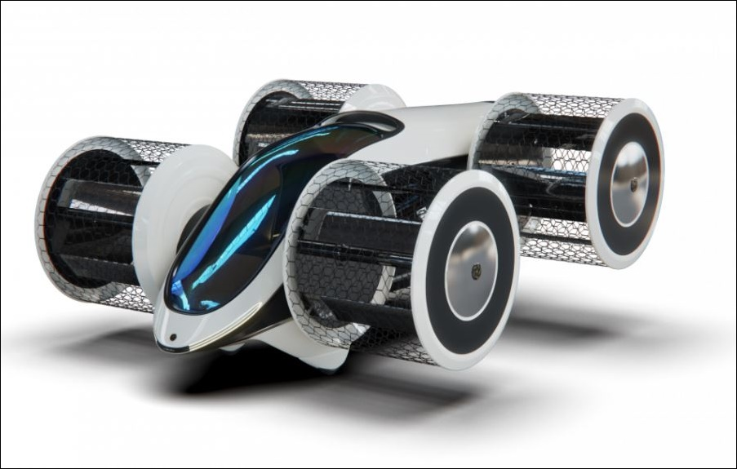

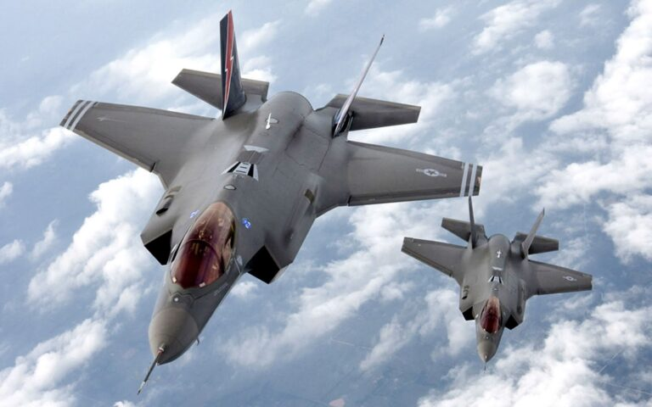

Background

Slide 3
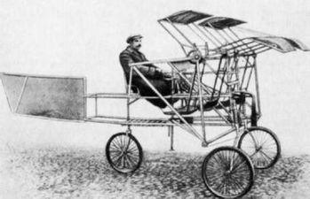
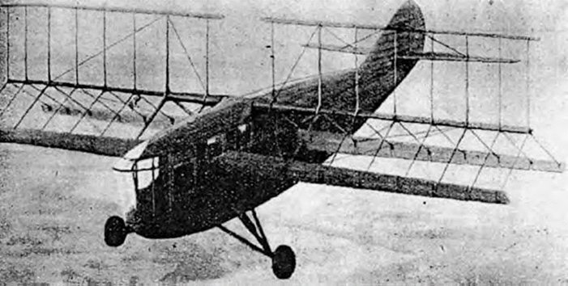
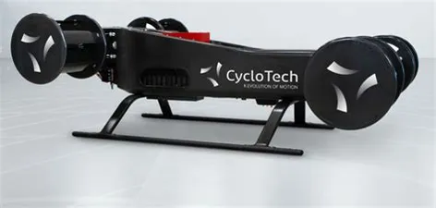
Background
Sverchkov's Samoljot, St-Peterburg, 1909 (Bowers)
Rohrbach's Cyclogyro, 1933 (Arndt)
CycloTech Gmbh, 2021

Slide 4
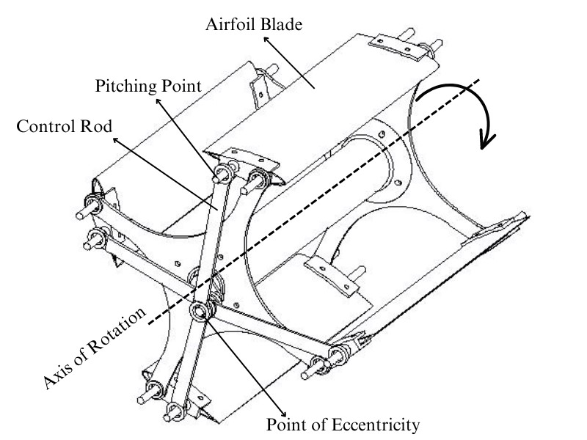
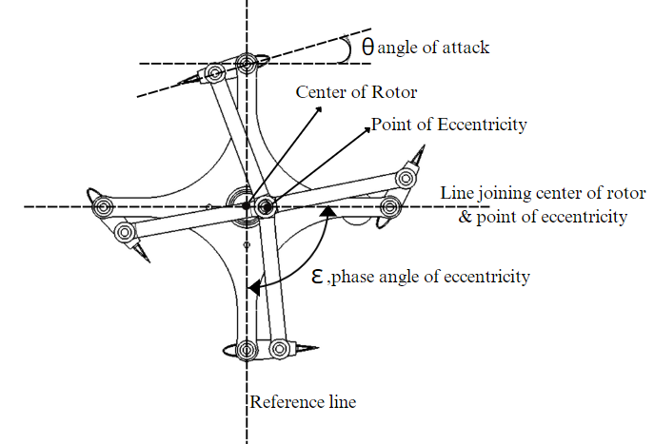
Introduction

Slide 5
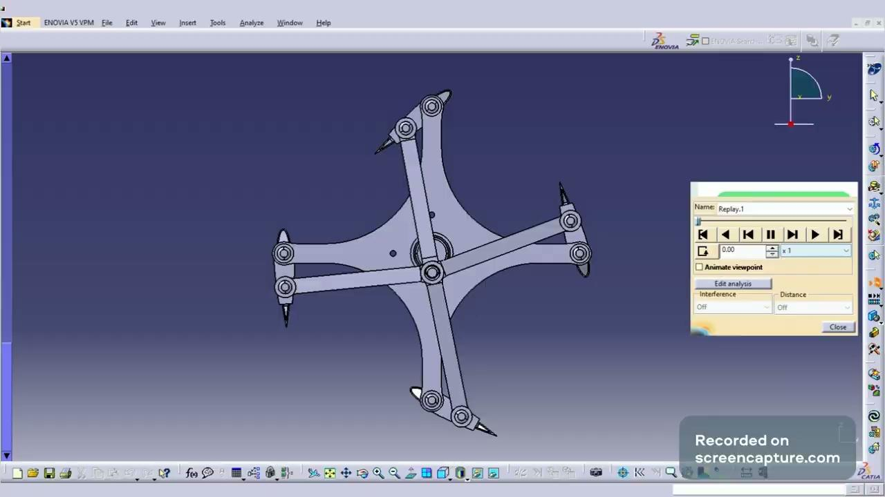
Introduction

Slide 6
Need for the Study
Study of the system in hover state only
Flight control system implied are conventional type
No test of implication of variable pitching mechanism
No study of viability of cyclorotor with variable pitching mechanism for use in air-vehicle

Slide 7
Design Parameters
Airfoil NACA 0015
Rotor diameter 152.4 mm
Total blade span 171 mm
Chord Length 50.8 mm
Pitching axis location 25% of chord from leading edge
Actuation point 17.5 mm from Pitching axis
Total length of control rod 76.2 mm

Slide 8
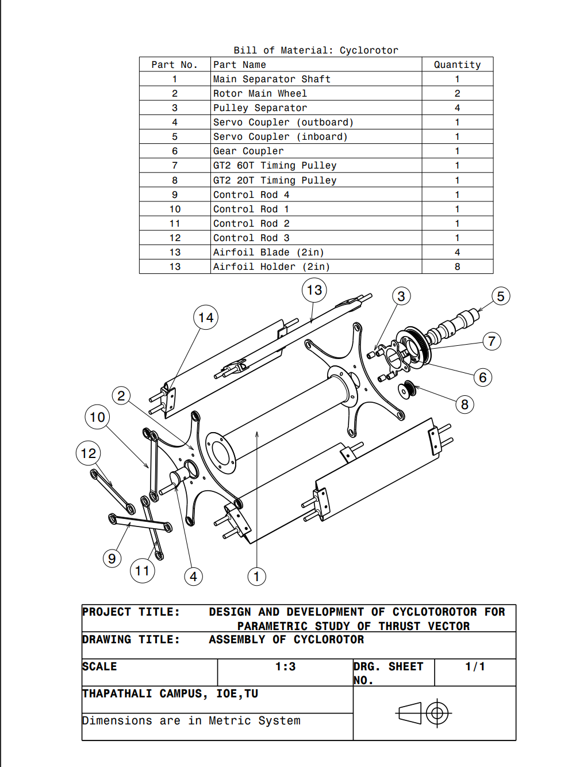
Assembly

Slide 9
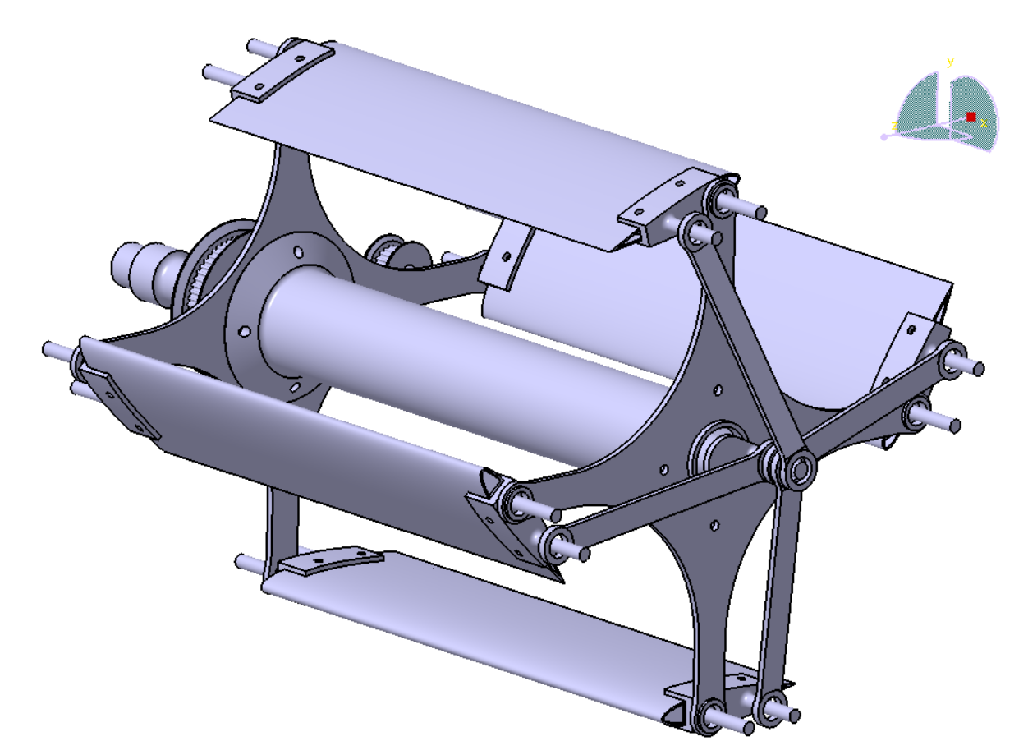
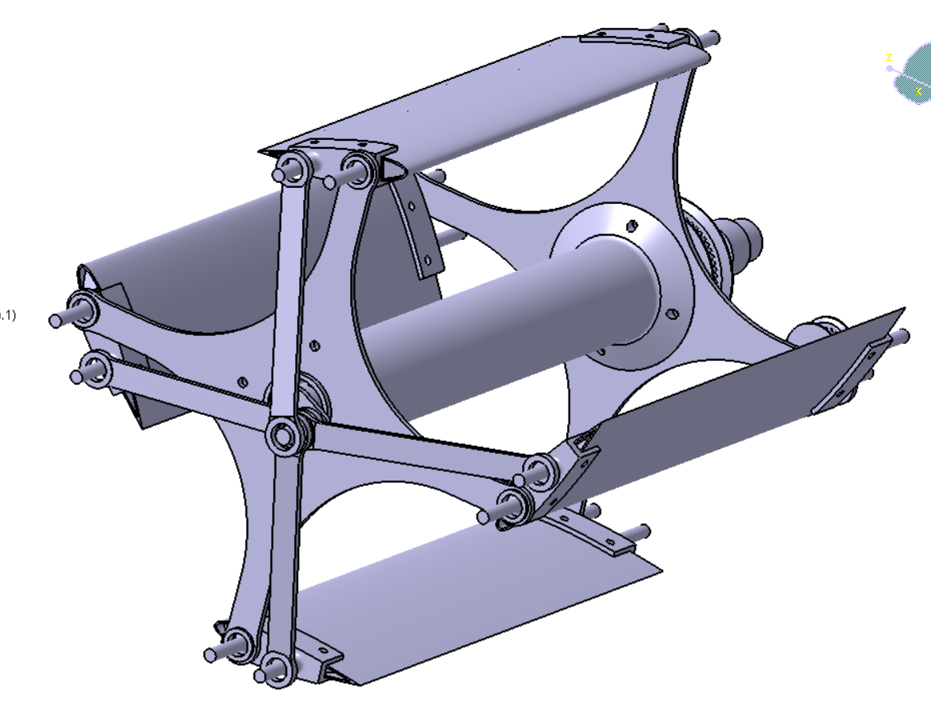
Assembly

Slide 10
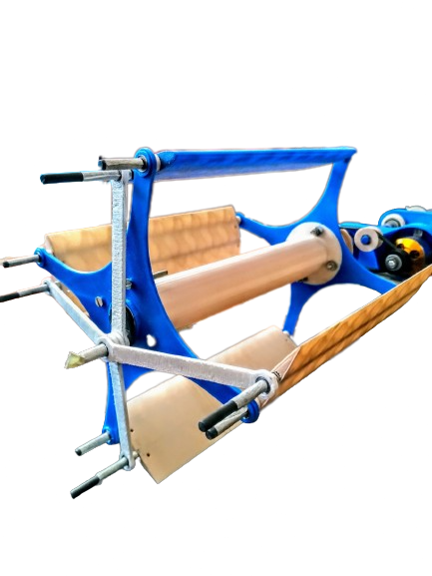
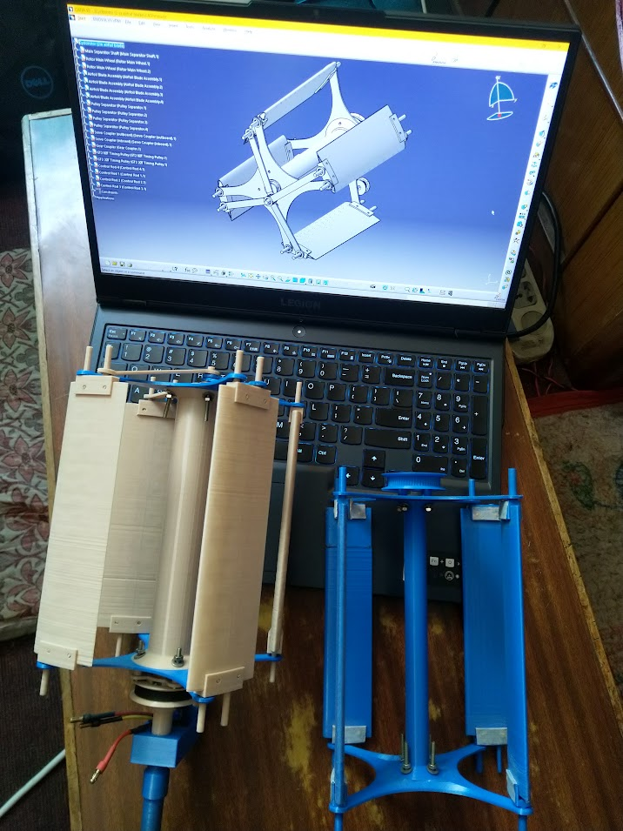
Assembly

Slide 11
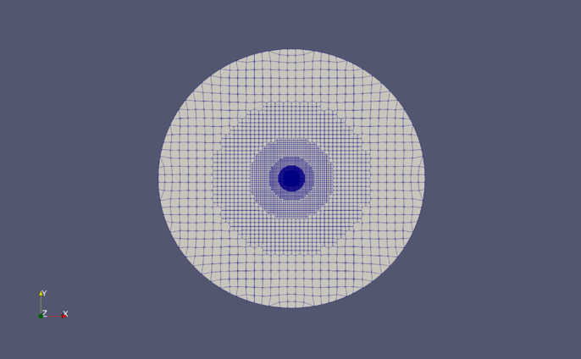

Simulation
OpenFOAM
snappyHexMesh
Front view of Mesh
Zoomed view of Mesh with AMI

Slide 12
Simulation
Simulation Parameters
SST K-ω TURBULENCE MODEL
pimpleFoam Solver
S.No | Parameters | Values
1 | Flow velocity | (0,0,0)
2 | Kinematic pressure(m²/s²) | 0
3 | RPM | 1400
4 | Center of rotation | (0,0,0)
5 | Axis of rotation | (0,0,1)
6 | Center of rotation (Pitching motion) | (0.1,0,0)
7 | Incident velocity of air for each blade | 11.17 m/s

Slide 13
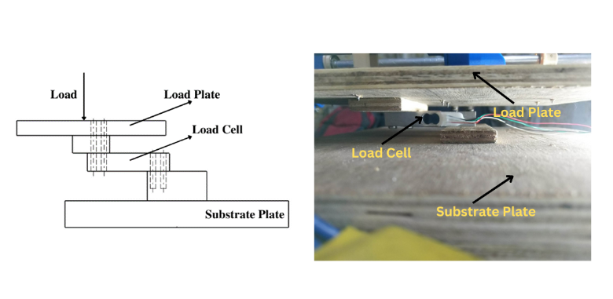
Test Rig

Slide 14
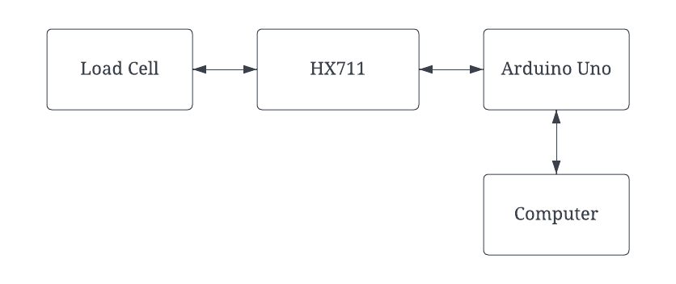
Test Rig
System Architecture of Test Rig

Slide 15
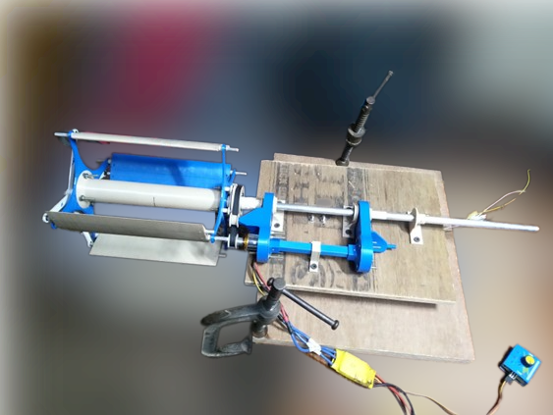
Experimental Setup
Speed 1343 RPM

Slide 16
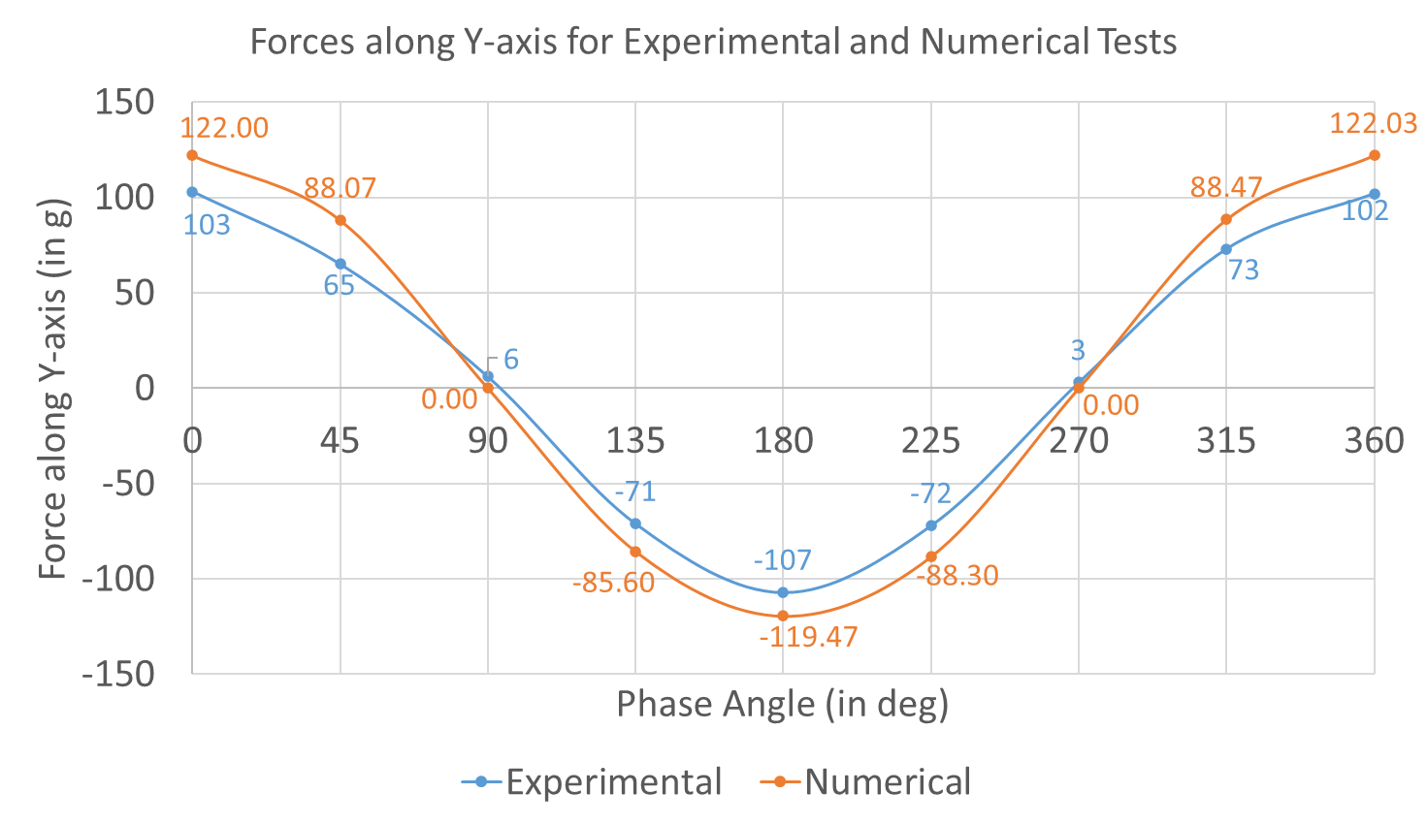
Results

Slide 17
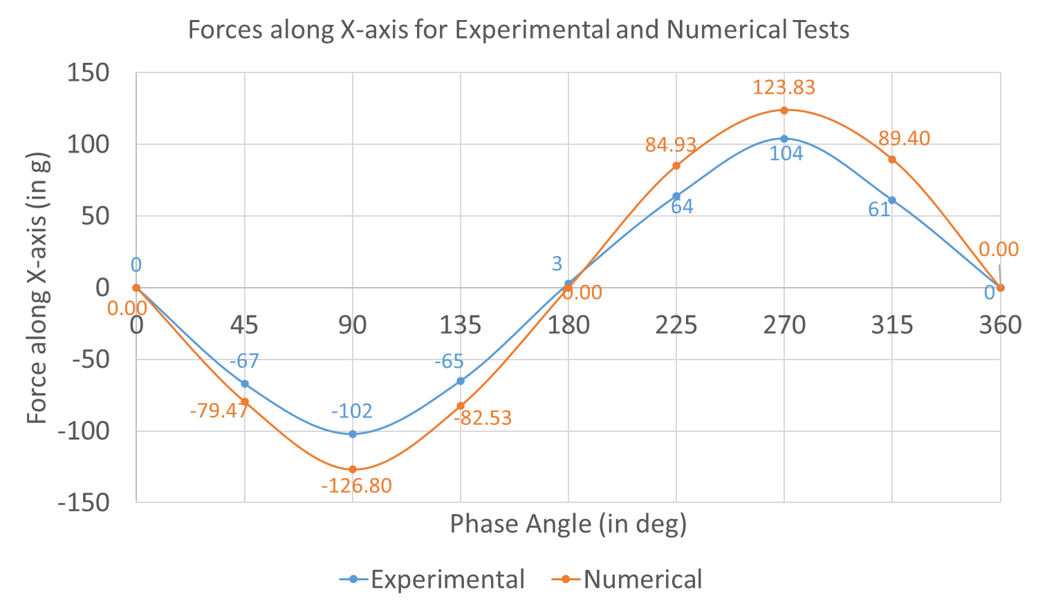
Results

Slide 18
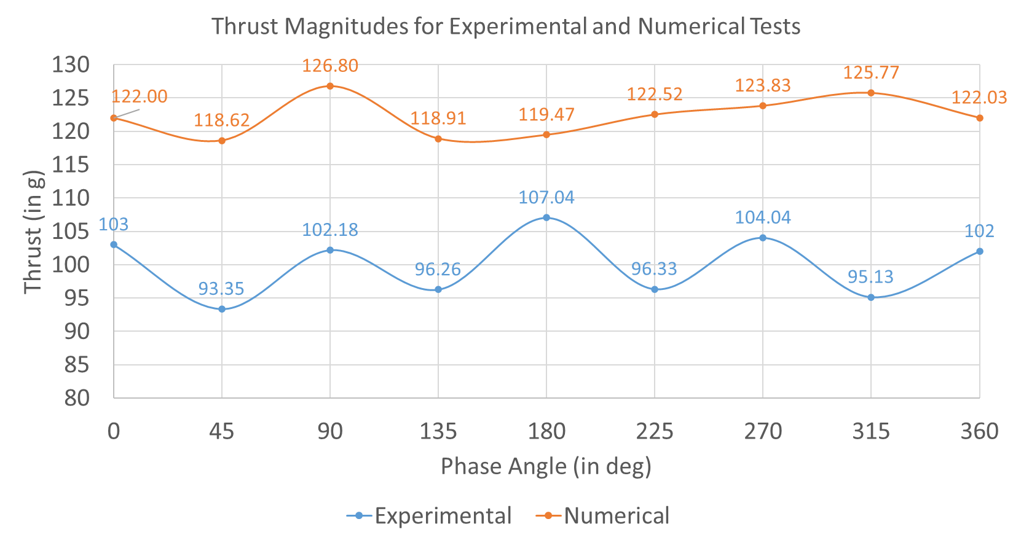
Results

Slide 19
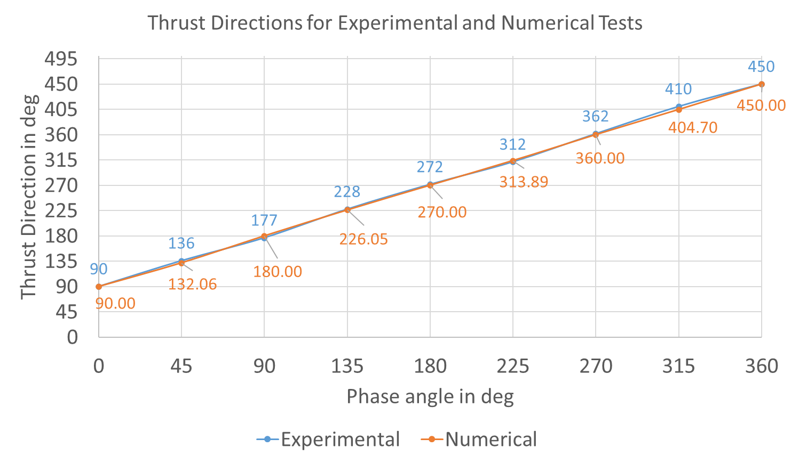
Results

Slide 20
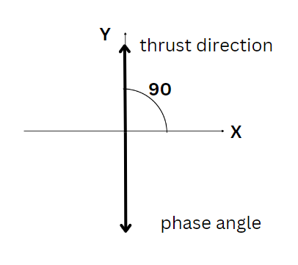
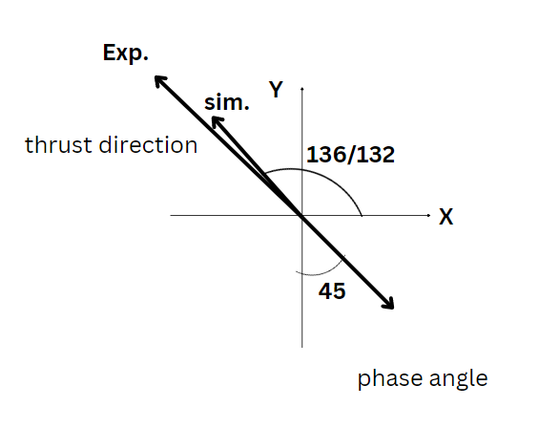
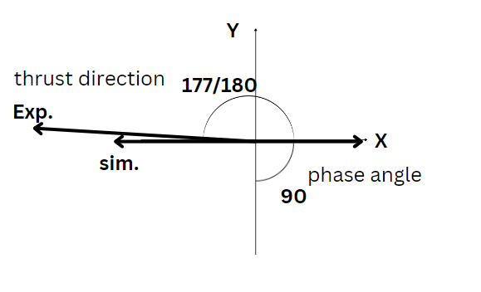
Conclusion
Thrust vector pattern for different pitching angles

Slide 21
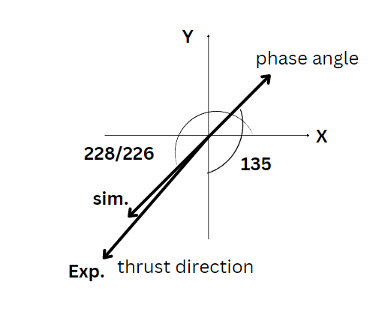
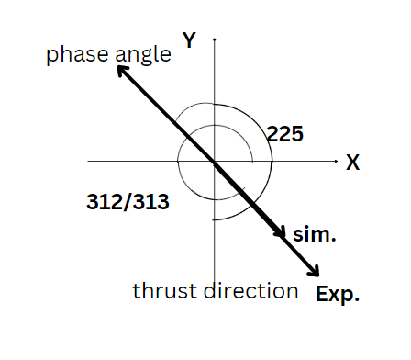
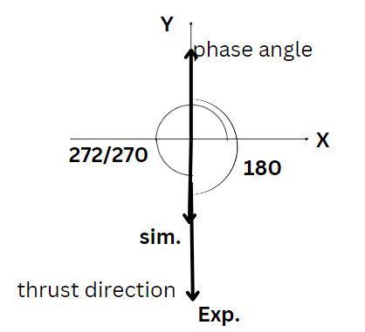
Conclusion
Thrust vector pattern for different pitching angles

Slide 22
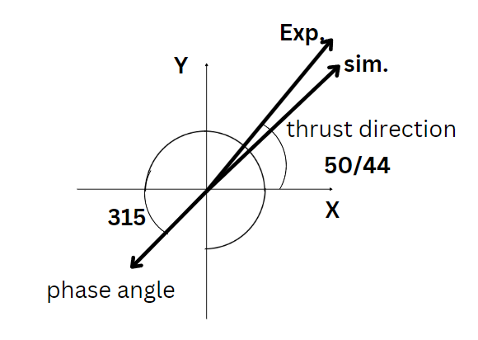
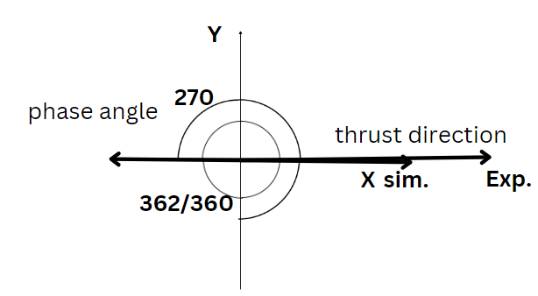
Conclusion
Thrust vector pattern for different pitching angles
Direction of thrust is approximately opposite to the phase angle

Slide 23
Summary
Design, Manufacture & Fabrication of cyclorotor
Simulated in OpeanFOAM
Experimental study of the system
Simulated results and experimental results show similar characteristics
Yield thrust vector pattern
Advantage & application of the thrust vector
Better thrust vector control system can be formulated using the conclusion for better flight characteristics of the cyclorotor

Slide 24
THANK YOU

Slide 25
References
Bowers, P. M. (2013, June 8). ROTOPLAN. Retrieved June 25, 2022, from rotoplan.narod.ru: http://www.rotoplan.narod.ru/history_e.htm
Arndt, R. (n.d.). Rohrbach Cyclogyro. Retrieved June 25, 2022, from discaircraft.greyfalcon.us: http://discaircraft.greyfalcon.us/Rohrbach%20Cyclogyro.htm
CycloTech Home - CycloTech Reovlution of motion. (2021). (CycloTech GmbH) Retrieved June 25, 2022, from cyclotech.at: https://www.cyclotech.at/

